Slide 1
How to
Dividends & Compounding

Slide 2
Disclaimer
This presentation has been prepared by the Retire First team. This presentation expresses the opinions of the presenters, and not necessarily those of Retire First Ltd. Statistics and factual data and other information in this presentation are from sources Retire First believes to be reliable, but their accuracy can not be guaranteed. This presentation is presented on the basis and understanding that Retire First is under no liability whatsoever in respect thereof. It is for informational purposes only and is not be construed as an offer or solicitation for the sale or purchase of securities. Retire First Ltd. and its officers, directors, employees and their family may from time to time invest in the securities discussed in this presentation. This presentation is intended for distribution only in those jurisdictions where Retire First Ltd is registered as a dealer in securities. Any distribution or dissemination of this presentation in other jurisdictions is strictly prohibited. This presentation is not intended nor should it be distributed to any person residing in the USA. Retire First Ltd. is a member of the Canadian Investor Protection Fund. Commissions, trailing commissions, management fees and expenses all may be associated with mutual funds. Please read the prospectus before investing. Mutual funds are not guaranteed, their values change frequently, and past performance may not be repeated. A recommendation of any of the mentioned investments would only be made after a personal review of each individual’s portfolio. Third Party research has been used in formulating the writer's opinions.

Slide 3
Doug Allan, president & portfolio Manager Bradley Lamash, Portfolio manager Kate allan, Portfolio Manager
403 314 5553
doug.allan@retirefist.com
bradley.lamash@retirefirst.com
kate.allan@retirefirst.com
www.retirefirst.com

Slide 4
Strategy
To deliver a stable and sustainable total return stream through changing market environments with companies with sustainable dividends and with the ability to grow those dividends over time.
Portfolios are primarily composed of high quality, dividend-paying securities, where share prices are measured against the sustainability and potential growth of the dividend income stream.
Over time, the income produced by the portfolio represents a significant portion of the expected total return, leaving less emphasis on stock price performance.
Over time, the focus on long-term dividend growth allows the portfolio to provide a growing stream of annual income which can be used as needed or reinvested and compounded for additional growth.

Slide 5
Portfolio Construction
Concentrated portfolios of 10-25 equity holdings based on portfolio size. Each portfolio is constructed based on the client’s rate of return requirements. We are not inclined to own the market and, as a result, our strategy comes in and out of favour. This strategy stands apart from others as we are only concerned with owning the most optimal portfolio that will help clients achieve their goals over their individual time horizon.
We are not focused on outperforming the market or buying the latest hottest trend (Bitcoin/Marijuana).
Our portfolios aim to provide capital preservation, while funding an ongoing personal liability stream. Dividend-paying equities have consistently provided a lower volatility total return stream when compared with the broad stock market (chart below), with a higher income level than could otherwise be achieved in the bond market.

Slide 6
Note: dividend growers in Canada have significantly outperformed both the TSX and S&P 500 on a total return basis over the last three and a half decades, especially when volatility, as measured by standard deviation, is considered. Canadian oligopolies in the Financial, Utility, Telecommunications and Energy Infrastructure sectors have consistently provided above average total returns with lower risk and the added benefits of lower taxes and currency risk for Canadian investors. As such, these sectors are well represented in the portfolios.

Slide 7
Portfolio Construction
Volatility control is the psychological and mathematical key to matching an investment portfolio to a client’s multi-decade time horizon, where they are consistently in need of capital.
Portfolios are composed primarily with Canadian equities. The Canadian market is home to a significant number of dividend-growers, with above-average yields that have been shown to both reduce volatility and outperform over time.
Additionally, Canadian dividend-payers provide a higher level of current income, lower taxes and less currency risk when compared to market relative strategies.

Slide 8
Dividend Growers Examples
2013: $1.295
2022: $3.55
174.13% Dividend Increase
2012: $2.82
2022: $5.72
162.84% Dividend Increase
2016: $.92
2022: $1.404
52.65% Dividend Increase
2013: $1.1148
2022: $1.30
16.61% Dividend Increase
2010: $1.26
2022: $2.32
84.13% Dividend Increase
1984: $2.205
2022: $3.68
66.90% Dividend Increase

Slide 9
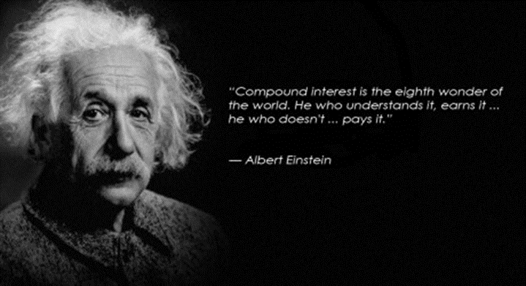
Dividends + Compounding =
Let’s look at the 2nd part of the formula, compounding and the role it plays in wealth creation
Albert Einstein once noted that the most powerful force in the universe was the principle of compounding. In investing, this manifests itself through something called compound interest

Slide 10
Time and Compounding
100 +5%
105 +5%
110.25+5%
115.76 +5%

Slide 11
Compounding
Compounding is a powerful tool as it helps exponentially increase your wealth over the long run and can help those seeking financial freedom.
Compounding is not a get rich scheme and takes patience.
There are 3 things that determine your compound rate of return:
Time
Interest Rate/Return/Dividend
Tax Rate
Let’s focus on the first 2. We want to maximize your RRSPs and TFSAs to take advantage of tax laws. For non-registered/cash accounts we would consult with your accountant to see if there is anything we need to be aware of.

Slide 12
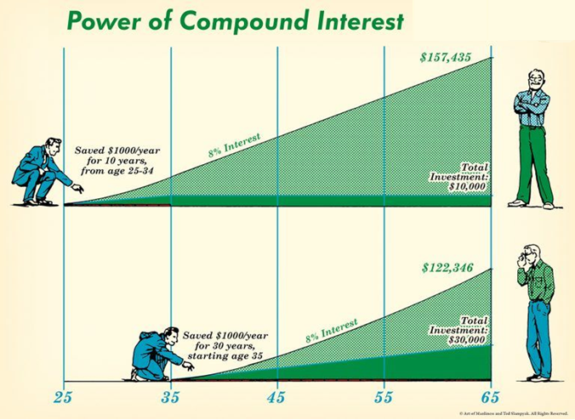
Time and Compounding

Slide 13
Rate of Return
Obviously, the higher your rate of return, the greater the benefits of compounding.
Example: a 5% return vs a 6% and 7% return for 15 years.
Starting Value | $100,000 | $100,000 | $100,000
Contributions | 0 | 0 | 0
Years | 15 | 15 | 15
Rate of Return | 5% | 6% | 7%
Ending Value | $207,893 | $239,656 | $275,903

Slide 14
Rate of Return
What would happen if you merely added topping up a TFSA with the current limit of $6000?
Interest | Value
5% | $343,838
6% | $387,691
7% | $437,231
The difference between a 6% and 7% return might not seem like much, but another way of looking at it is the difference between doubling your money in 12 years vs 10.3 years

Slide 15
Rate of Return
What happens if add 5 more years to the above example of starting with $100,000, adding $6,000/year for 20 years?
Interest | Value
5% | $473 645
6% | $554 670
7% | $650 160
A huge difference with a small difference in assumptions.

Slide 16
So, Who is this Strategy Right For?
Long term Investors who:
-are looking to lower their volatility
-create an income stream to fund your retirement
-boost their wealth
-have a long-term time frame
This is not for investors who:
-want to day trade
-buy the latest trend stock in the market that are unproven (Bitcoin/Pot)
-want to buy penny stocks
- wanting a get rich quick
- people who overreact and make knee jerk reactions to the first market
downturn

Slide 18
Conclusion
We take a look at your current assets and financial goals/requirements then determine what rate of return you need by using the same financial formula that we used in the examples above.
Once we know this number, we can build a portfolio targeting that return. Why take more risk than is needed?
If it’s determined you require a 5% rate of return, we might construct a portfolio containing corporate bonds and dividend paying stocks.
If you needed a larger rate of return like 8%, we would have to include growth stocks that may not pay dividends.
Thanks to 24 hour news and constant bombardment of social media, every piece of small data seems like a stock market crash is never far away. The market will correct as it always does, that is a fact and something we can guarantee.

Slide 19
Conclusion Cont’d
So to end, let’s build wealth together. I am confident that our guide for building a dividend portfolio will boost your investment returns and help you achieve your financial goals.
We measure our success through the success of our clients meeting or exceeding their financial goals. We construct portfolios by purchasing a specific group of securities with a specific purpose in mind. Ideally, each company purchased could be held indefinitely, owing to successful results and dependable total return generation.

Slide 20
Dividends+Compounding=Retirefirst

